Slide 1
Bubble Sort
Insertion Sort
Selection Sort

Slide 2
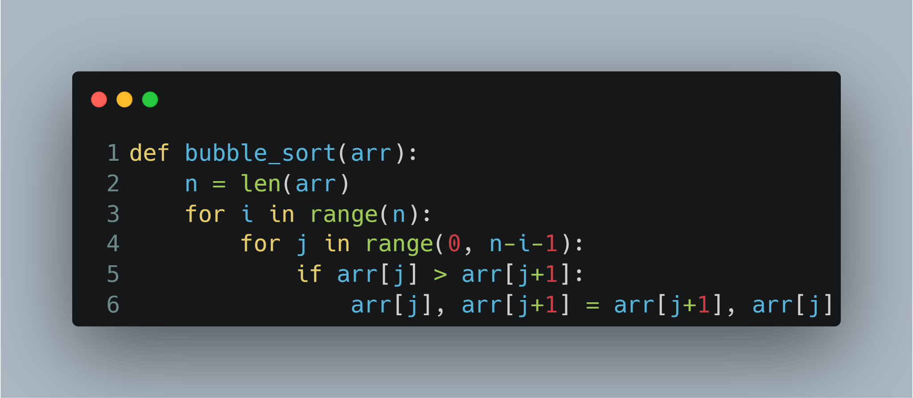
Bubble Sort
Best Case : Already Sorted. Time Complexity : O(n).
Average Case : Time Complexity : O(n²).
Worst Case : Sorted in Reverse Order. Time Complexity : O(n²).

Slide 3
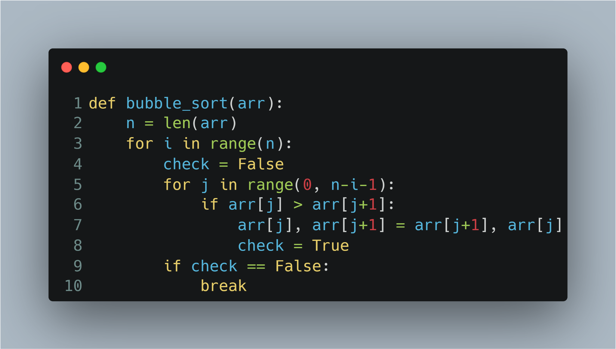
Bubble Sort
Best Case : Already Sorted. Time Complexity : O(n).
Average Case : Time Complexity : O(n²).
Worst Case : Sorted in Reverse Order. Time Complexity : O(n²).

Slide 4
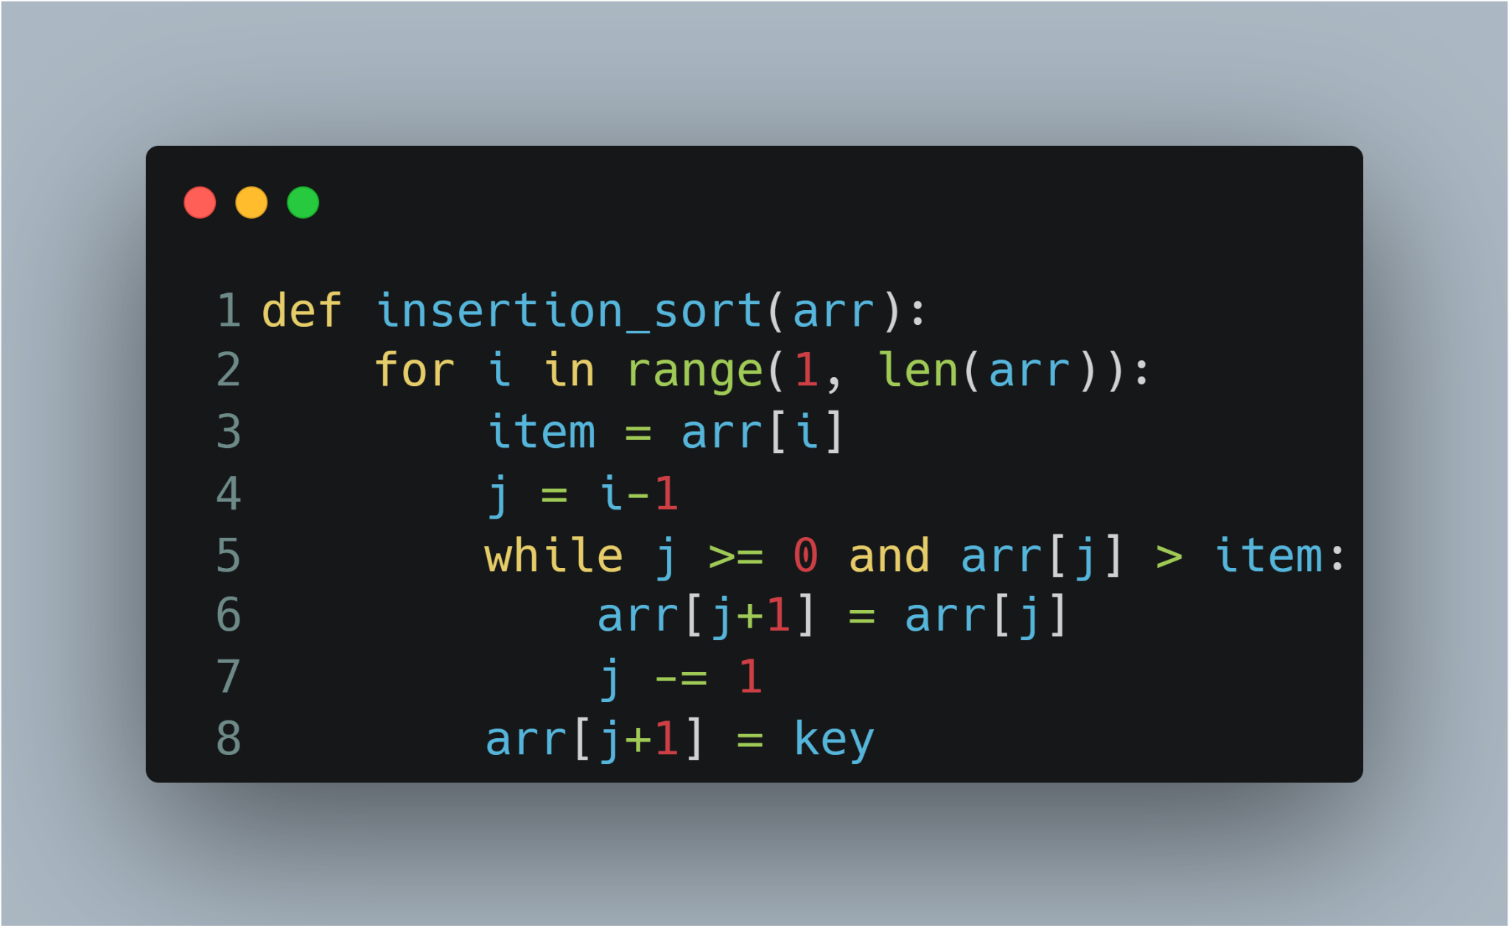
Insertion Sort
Best Case : Already Sorted. Time Complexity : O(n).
Average Case : Time Complexity : O(n²).
Worst Case : Sorted in Reverse Order. Time Complexity : O(n²).

Slide 5
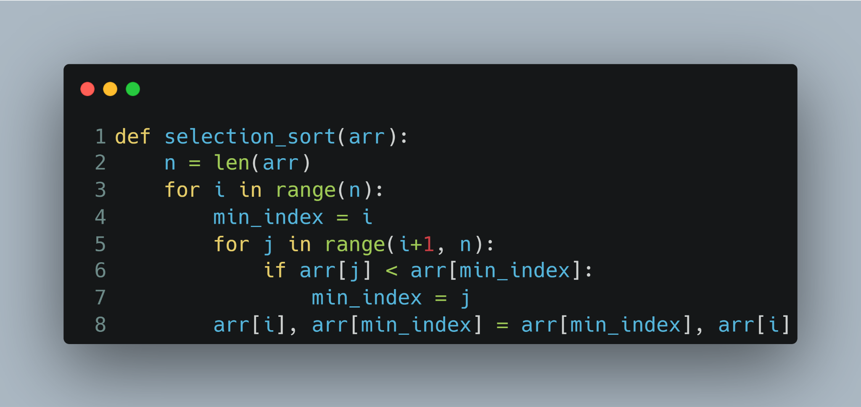
Selection Sort
Time Complexity : O(n²) in all cases.

